Slide 1


Slide 2
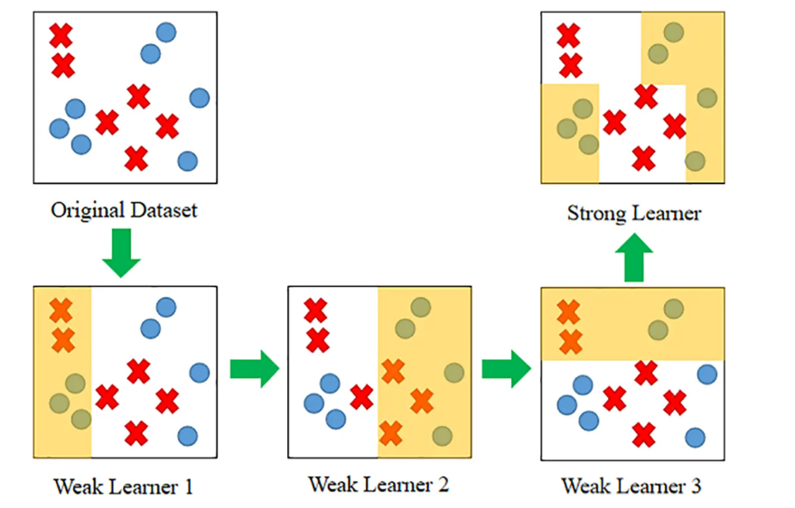
What is Boosting Algorithm ?
Boosting is a machine learning strategy that combines numerous weak learners into strong learners to increase model accuracy.
Boosting improves machine models predictive accuracy and performance

Slide 3
Why is boosting important?
Boosting improves machine models predictive accuracy and performance by converting multiple weak learners into a single strong learning model.
Weak Learners
Weak learners have low prediction accuracy.
Strong Learners
Strong learners have higher prediction accuracy.
Boosting converts a system of weak learners into a single strong learning system.

Slide 4
What are the benefits of boosting?
Improved Accuracy
Handles Complex Data
Adaptability
Flexibility
Feature Importance

Slide 5
What are the types of Boosting Algorithm ?
Ada Boost (or) Adaptive boosting
XG Boosting
LG Boosting

